Slide 1
ENNOVATIONS for DELIVERING SHARED VALUE:
EXAMPLES of PROVIDING COLLAGEN by DES
Prof.dr. Henk G. Sol
Professor of Business and ICT and Founding Dean
Faculty of Economics and Business
Professor of Systems Engineering and Founding Dean
Faculty of TPM
Delft University of Technology

Slide 2
Decision Enhancement in (Historical) Perspective
DSS 1980 dss managers are using computers as extensions of their minds
GDSS 1985 changing the technology and context of group decision making
EIS 1985 strategic information at your fingertips
ESDP 1990 environments to support decision processes
BPM 1995 business process management
BI 2004 real time business intelligence
Datawarehousing 2006 data inundation augmented by knowledge management
Dashboards 2008 intelligence in pictures
Analytics 2010 intelligent tools
Big Data 2012 handling volume, variety and verasity of data
Decision Apps 2013 integrated suites for dedicated decision enhancement
Conversations 2015 inquiry by small talk communities
Ennovations 2017 delivering shared value
(adapted from Omar El Sawy)

Slide 3
Inquiry in Perspective
From Inquiry Systems Extending the Mind
Through Environments for Decision Making
To Decision Enhancement Services
For Singerian Inquiry
In a Pragmatist Abductive Framework
‘Decision Enhancement Services: Rehearsing the Future for Decisions that Matter’, Peter G.W. Keen and Henk G.Sol, IOS Press, Amsterdam, 2008

Slide 4

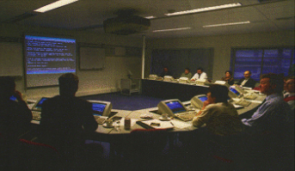
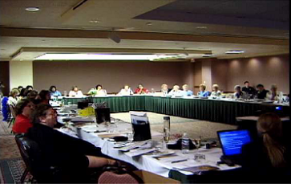
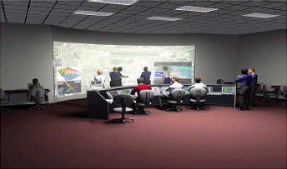
Ennovations for Delivering Shared Value: Providing Collagen

Slide 5
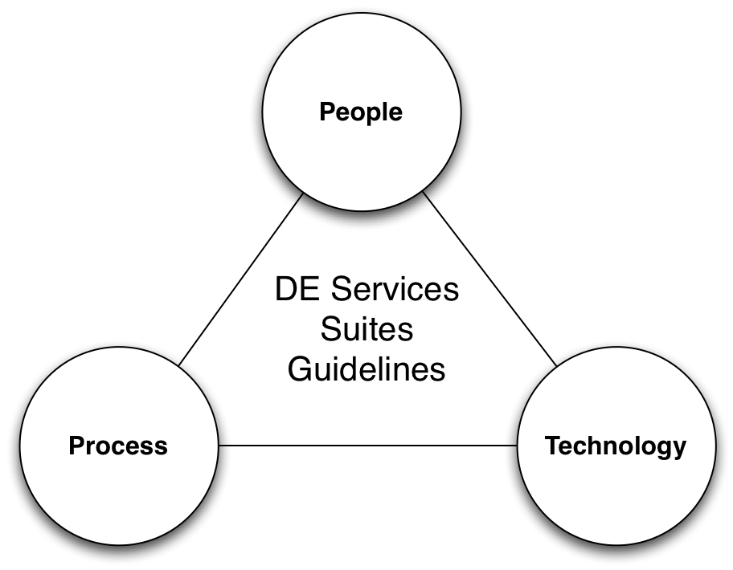
Providing Collagen

Slide 6
COLlective Learning Agile Governance ENvironment
Services
  For Framing Issues that Matter
  For Collaboration
  For Rehearsing the Future
  As Recipes for Decision Enhancement
Packed in Suites or Decision Apps
  With Guidelines for Conversations

Slide 7
Collagen in Detail
Way of thinking: decision apps in learning theatres
Way of modeling: business rules in local context, scripts for conversations
Way of working: best practices as recipes supporting conversations
Way of governance: co-ordinating conversations for delivering shared value

Slide 8
Collagen in Practice
Mainport development
Airport planning
Disaster planning
Smart villages
Traffic management
Prosumer shopping mall
Poultry farming
Asset management
Agro information
IS management
Miners startup
Sourcing public agencies
Business process agility
Water management
Maternity health
Indigenous knowledge

Slide 9
 | Process | Governance | Vision
Macro | COL | LA | GEN
Meso | DE | LIVER | ING
Micro | SHAR | ED | VALUE

Slide 10
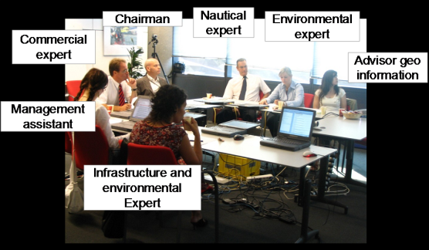
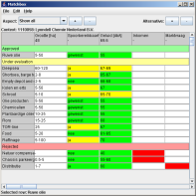
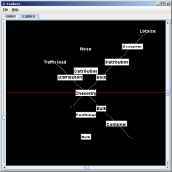
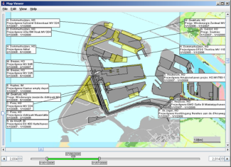
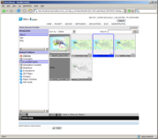
Mainport Development
A studio of services and guidelines to enhance spatial planning in the Port of Rotterdam

Slide 11
Mainport Development
Framing: development
with multiple actors,
heterogeneous data
Collaboration:
stakeholder analysis
dealing - wheeling
Rehearsing: suites for
simulation, gaming

Slide 12
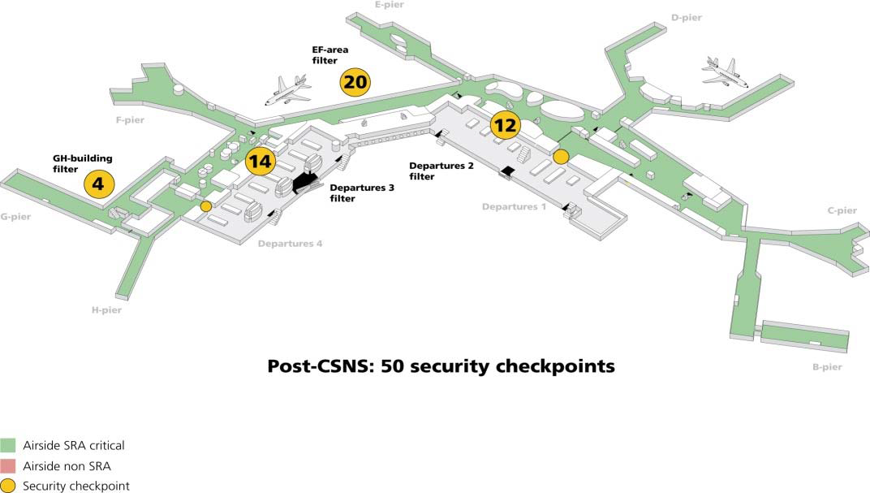
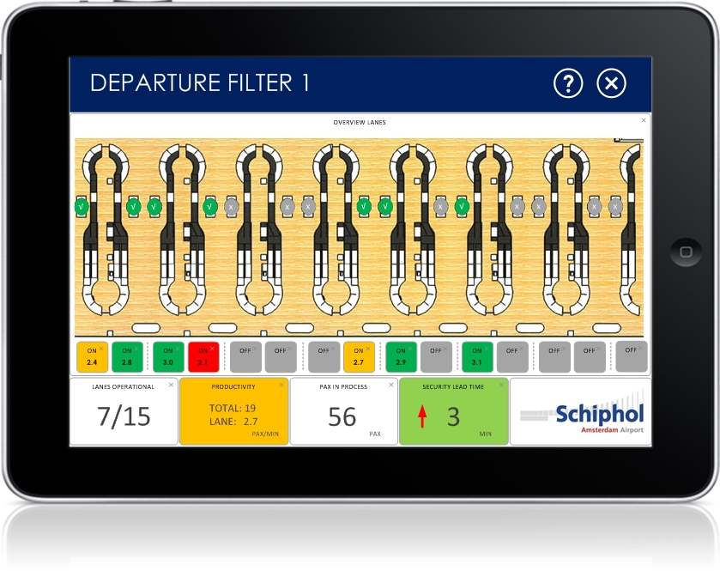
Schiphol Planning
A studio of services and guidelines to enhance development of Schiphol

Slide 13
Schiphol Planning
Framing:
balanced growth
Collaboration:
(inter)national and
local govts, airlines,
customs, police
Rehearsing: suites for
risk management,
terminal layout,
security,
luggage handling

Slide 14
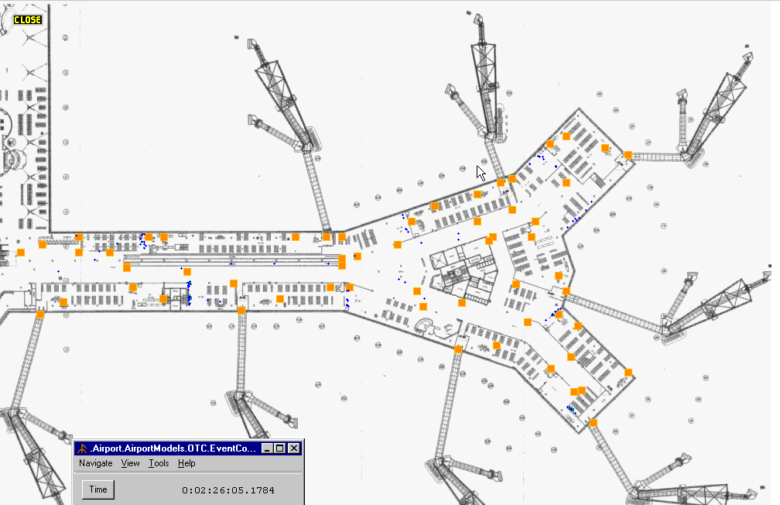
Gate simulation model
Notes:
Page 52 (Gate simulation model)

Slide 15
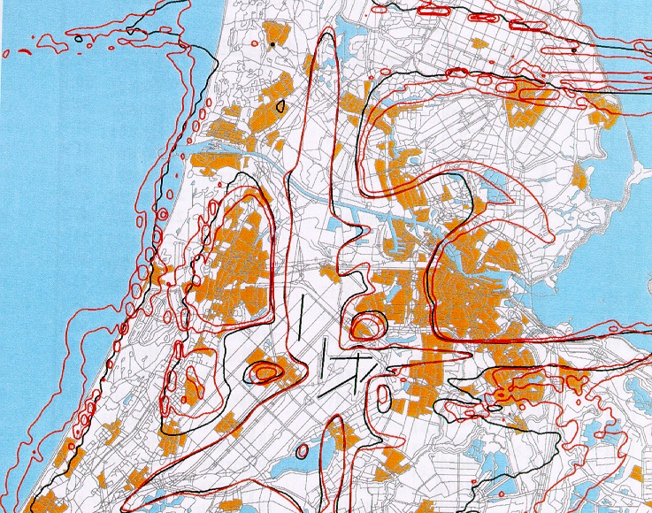
Schiphol noise contours
Notes:
53 (Noise contour around Schiphol)

Slide 16
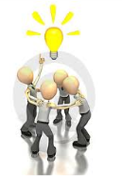







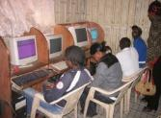


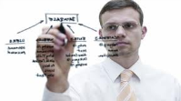

Enhancing Startup Miners
Problem | SME Start-up Failures in Mining
Ennovation | Regional Platform
Facilitate proactive development of mining SME start-up services in rural areas service centers
Guidelines for mining SME start-ups
ICT enabled service delivery to rural mining entrepreneurs
Responsive request for services, tracking, and feedback.
Elimination of middlemen as well as reduce the time to access services

Slide 17
Enhancing miners startups
Problem | SME Start-up Failures in Mining
Ennovation | Studio Enhancing SME Start-ups
Services and Guidelines:
GIS for Mining
Land Acquisition
Financing
Legal Advise
Business planning
Resource allocation

Slide 18
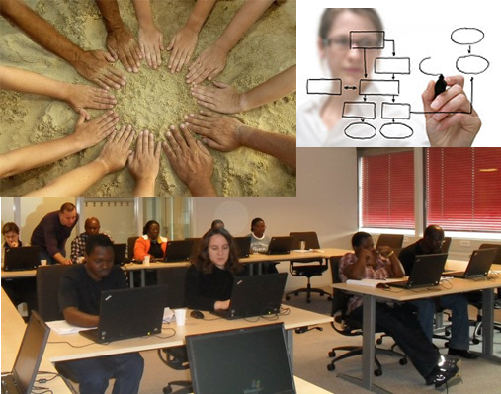
Agility in Social Security Systems
Problem | Achieving Business Process Agility (BPA)
Ennovation | Decision Enhancement Studio for BPA
Support business process analysis (bottlenecks, throughput time)
Support Risk Assessment of business processes
Guidelines on how to collaborate in identifying BPA opportunities, generating and selecting BPA alternatives

Slide 19
Agility in Social Security Systems
Problem | Achieving Business Process Agility (BPA)
Ennovation | Decision Enhancement Studio for BPA
Framing:
Identifying bottlenecks
Collaboration:
Analysing external developments
Generating and selecting BPA alternatives
Rehearsing:
Simulations
Evaluations
Software generation

Slide 20
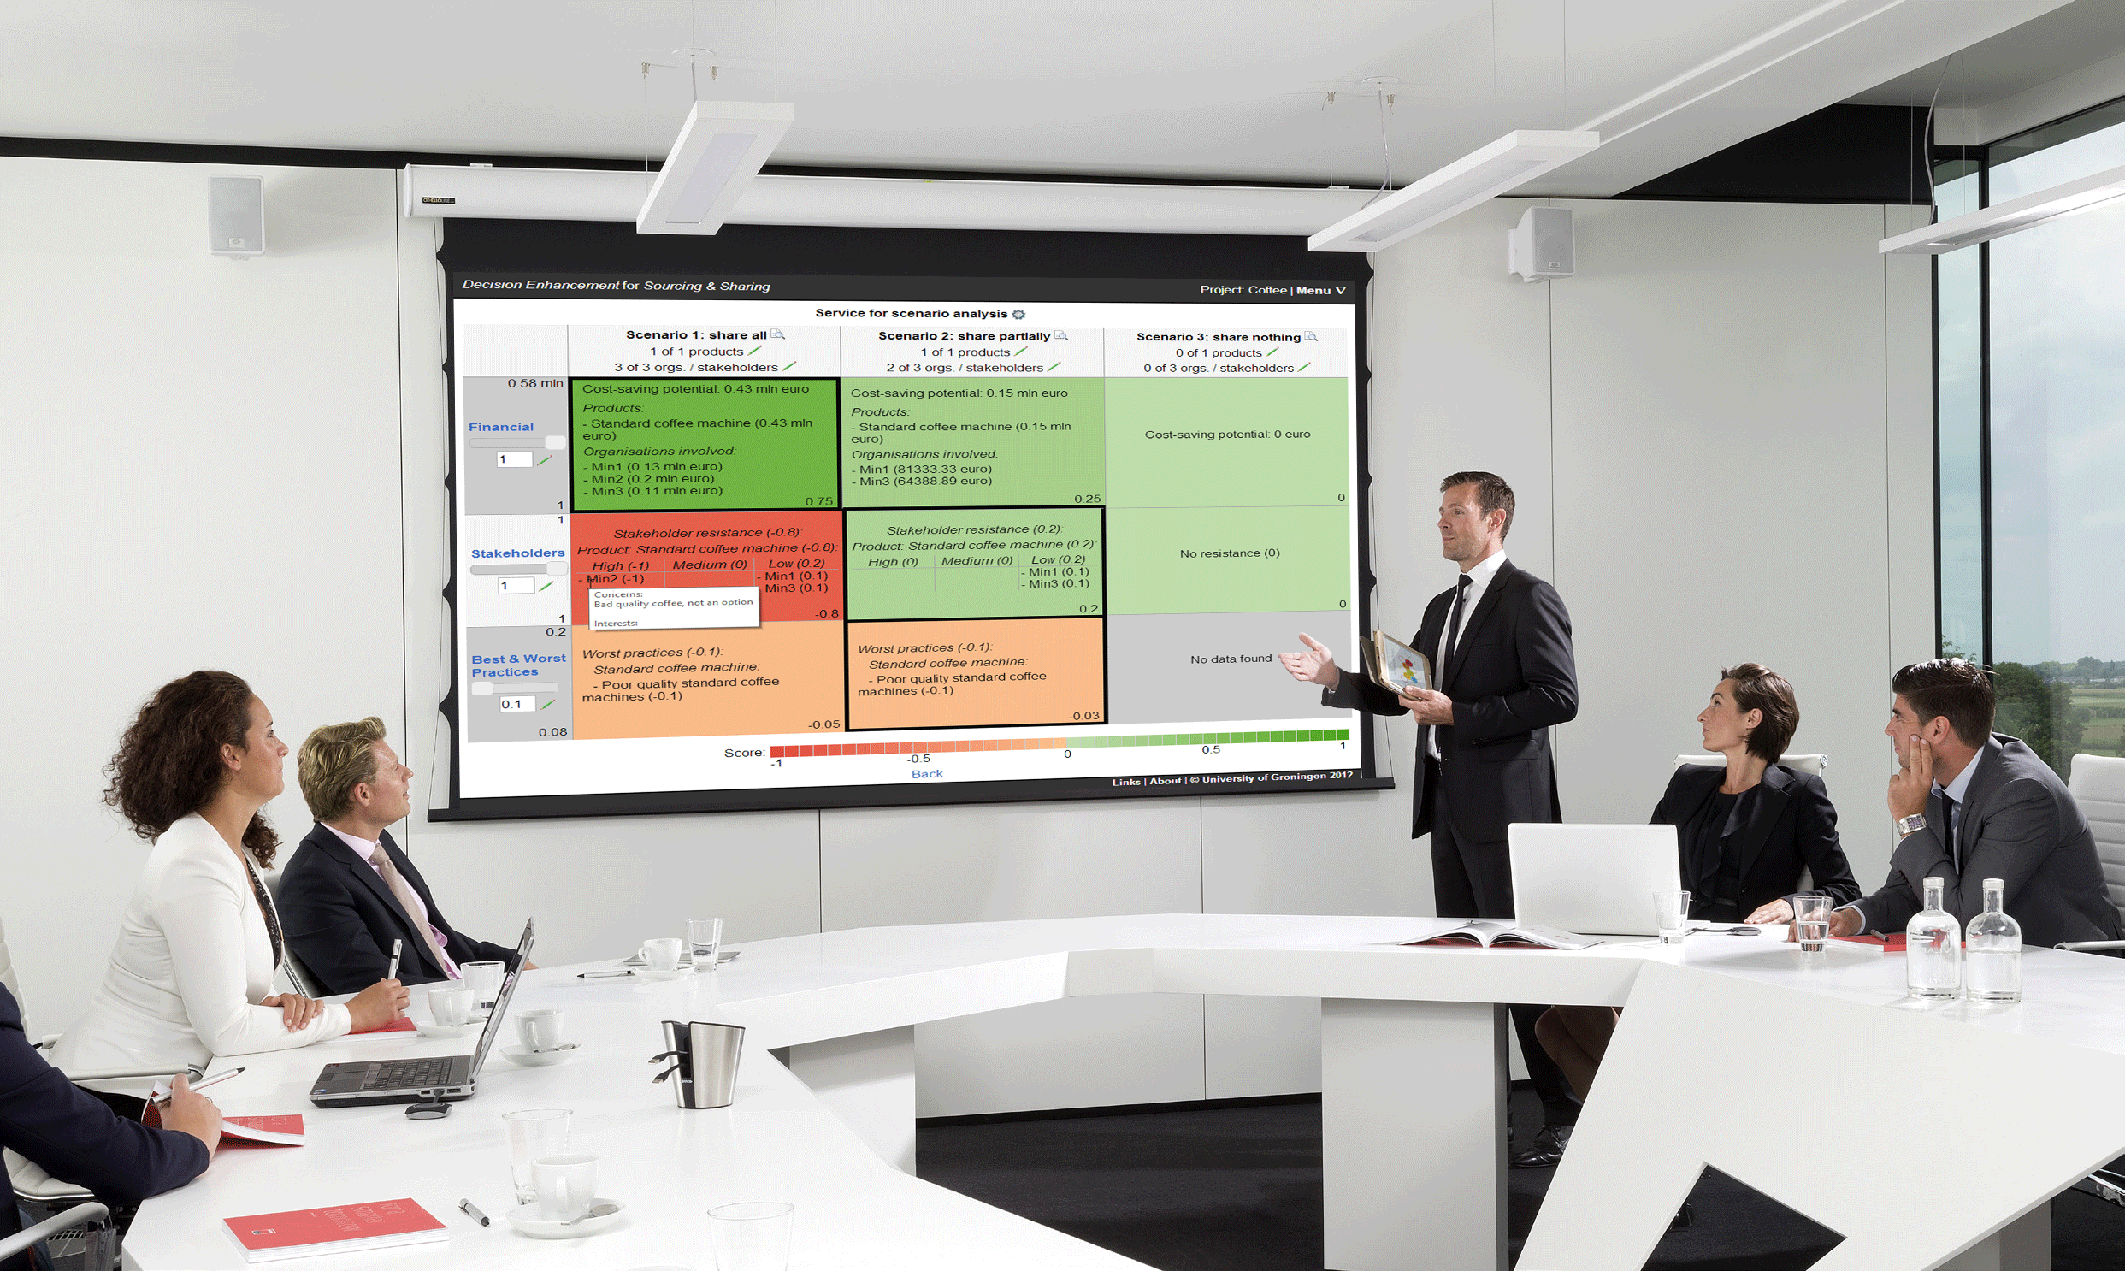
Reorganizations in the Public Sector
Problem | Frequent failure of reorganization projects due to predominant focus on cost-savings whilst ignoring stakeholders, experts and alternative scenarios
Ennovation | Studio to generate, analyze, negotiate, and select reorganization scenarios during group sessions
Decision app and collaboration process for scenario negotiation and selection
Quotes from 2 pilot cases and 2 cases:
“Creates overview”
“Creates a shared picture”
“Due to the colours immediate insight in attractiveness”
“Creates understanding for everyone’s views”
“Helps for the strategy that needs to be formed”
“Objectifies”
“Enables discussion”
“Not only financial”
“Quick results”
“Visual”
“To the point”
“Fun to do”
Facilitator
Problem
owners
Stakeholders and experts

Slide 21
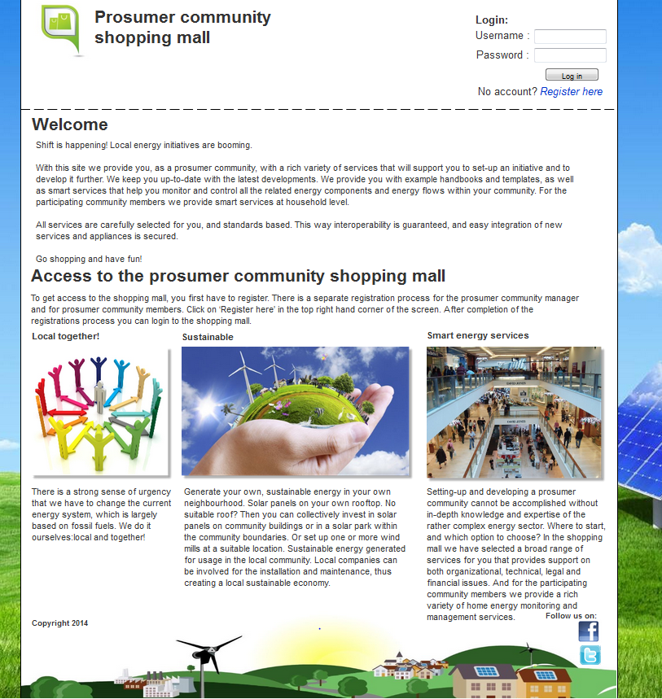
Prosumer Community Development
Problem | Growth of Local Energy Communities
Ennovation | Shopping Mall for Prosumer Communities
Framing:
Facilitating the growth of local energy communities
Collaboration:
Platform for prosumer communities and stakeholders (i.e. authorities, energy service providers)
Rehearsing:
Online shopping mall (suites) providing decision enhancement services for growth path support

Slide 22
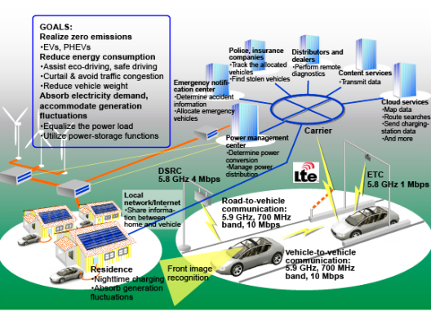
Renewable Energy Generation
Problem | Transition to Smart Energy Communities (SC) In Developing Countries
Ennovation | Studio of Services for SC
Framing:
Smart grids and renewables
Collaboration:
Create conversations
Rehearsing:
Simulate REG innovations
Transition interventions
www.wananchi.go.tz
Notes:
22

Slide 23

Water Asset Management
Problem | High share of Non Revenue Water owing to poor infrastructure in developing countries
Ennovation | A studio for asset management
Framing:
Asset management ,policy balancing, corruption, fraud and millennium goals
Collaboration:
Multiple stakeholdes with different metrics and methods
Rehearsing:
Simulating interventions
Visualisation

Slide 24
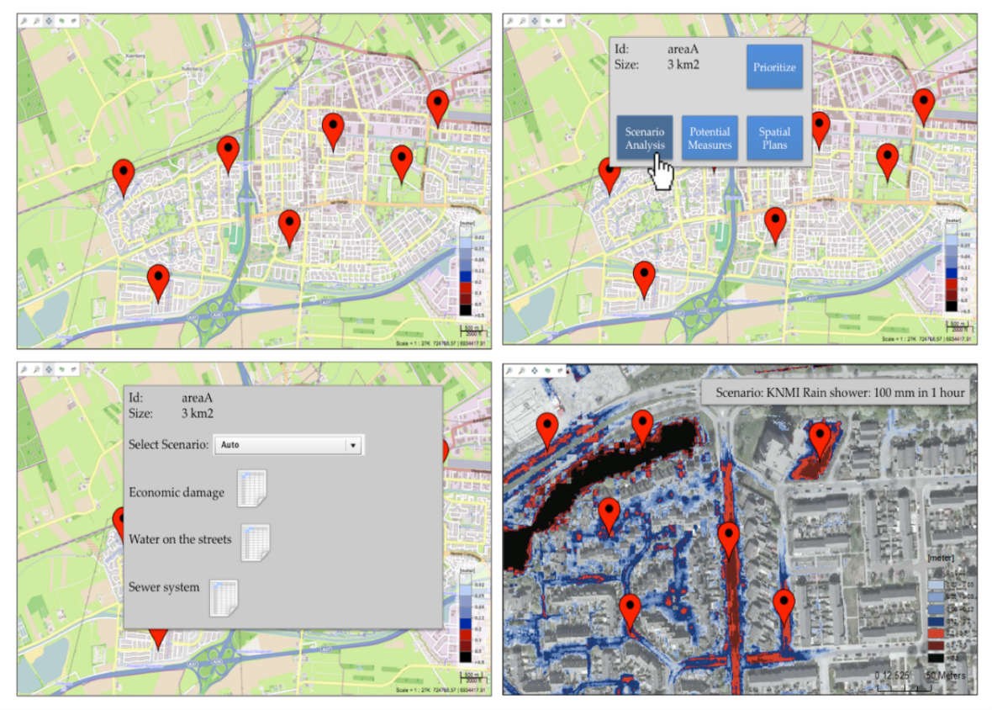
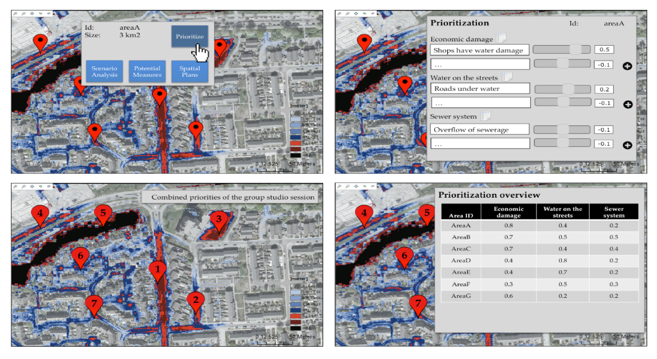
Water Management and Flooding
Problem | Risks for flooding due to climate changes
Ennovation | A studio to discuss water asset options

Slide 25
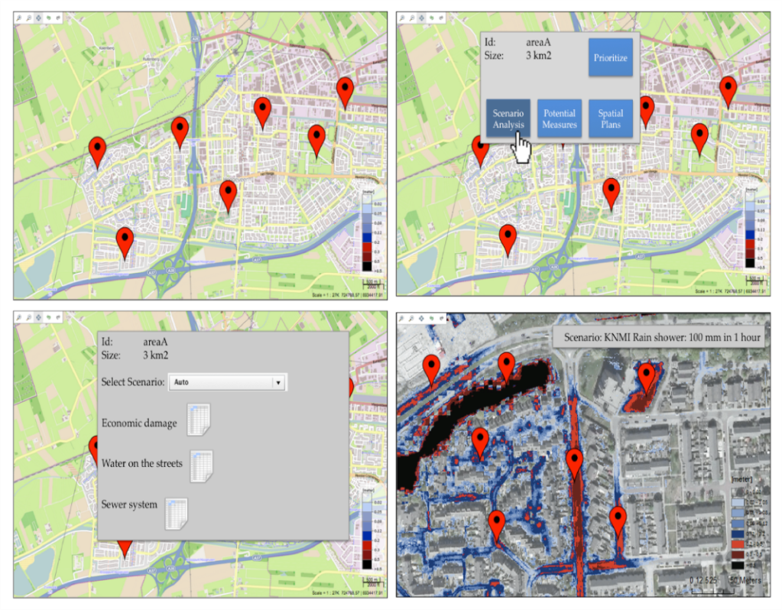
Water Management and Flooding
Problem | Risks for flooding due to climate changes
Ennovation | A studio to discuss water asset options
Framing:
Influencing political bodies
Collaborating:
creating awareness
budget allocations
Rehearsing:
GIS flooding models
Collaborative scenarios
Federated data models

Slide 26
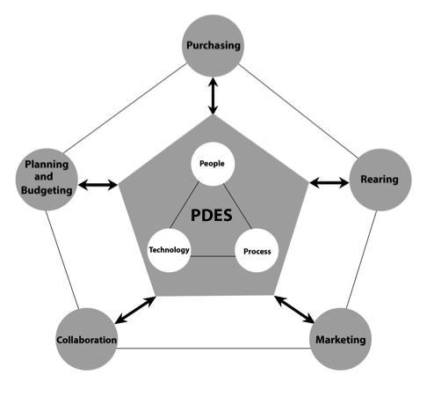
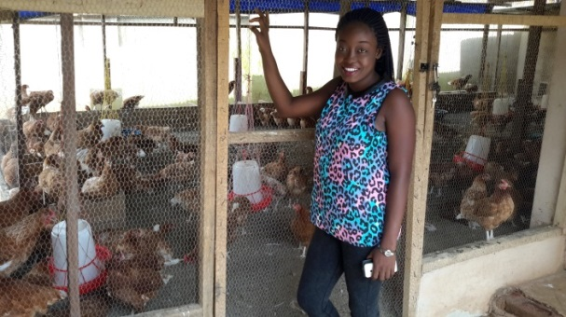
Poultry Farming
Problem | Enhancing decision making in poultry farm management
Ennovation | Poultry Decision Enhancement Studio
Framing:
Decision making across the poultry farm management processes
Collaboration:
Farmers, regulators, suppliers, veterinians, extension officers, customers
Rehearsing:
Visualisation

Slide 27
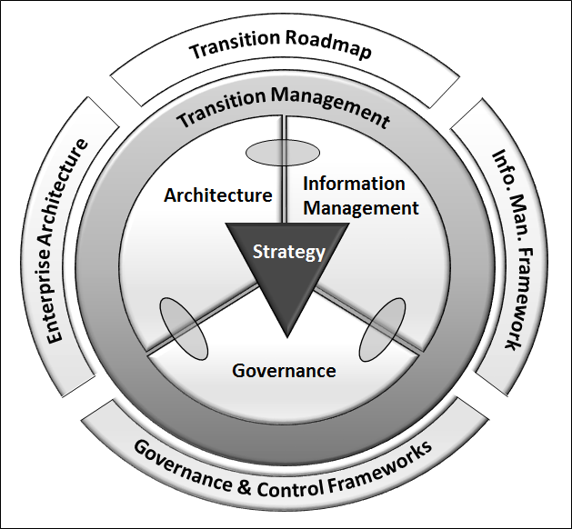
Digital Governace for Infrastructure Asset Management
Problem | Enhancing Infrastructure Asset Management by Digital Governance
Ennovation | The Rand Water Way
Framing:
Implementing enterprise-wide digital governance; sustainability
Collaborating:
Asset managers
Rehearsing:
Statistical analysis
Forecasting
Dashboarding

Slide 28
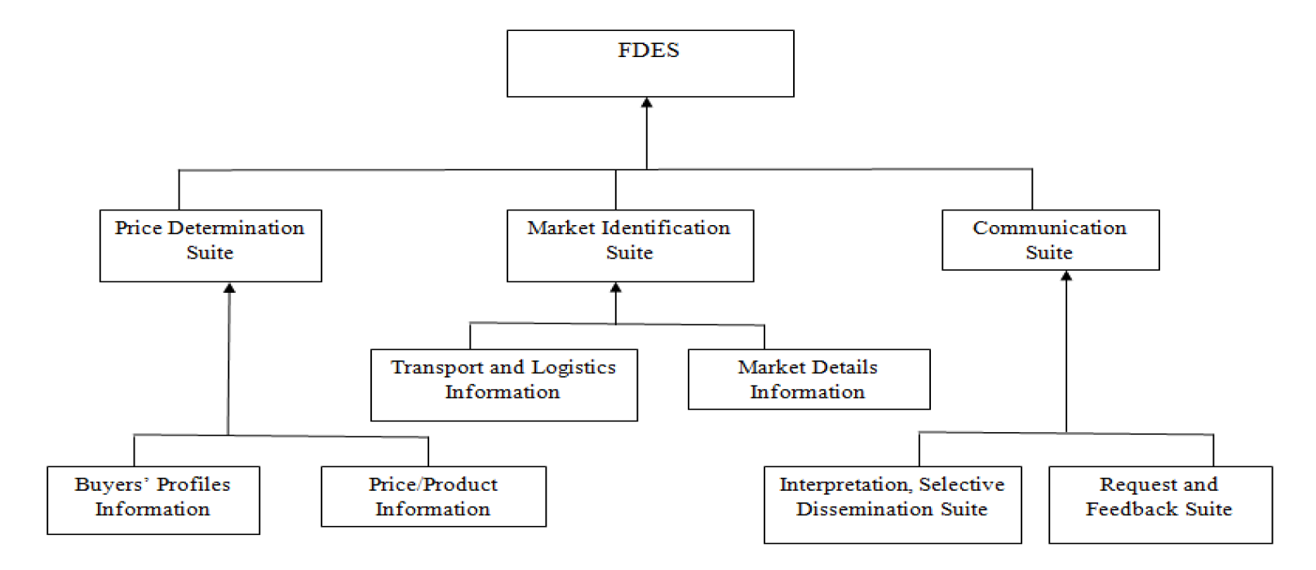
Agricultural Information Services
Problem | Farmers’ market and price decision making challenges
Ennovation | Farmers’ Decision Enhancement Studio (FDES)
Framing:
Enabling equitable access to markets for farmers
Collaborating:
Farmers, Buyers
Rehearsing:
Visualisation
Information Analysis

Slide 29
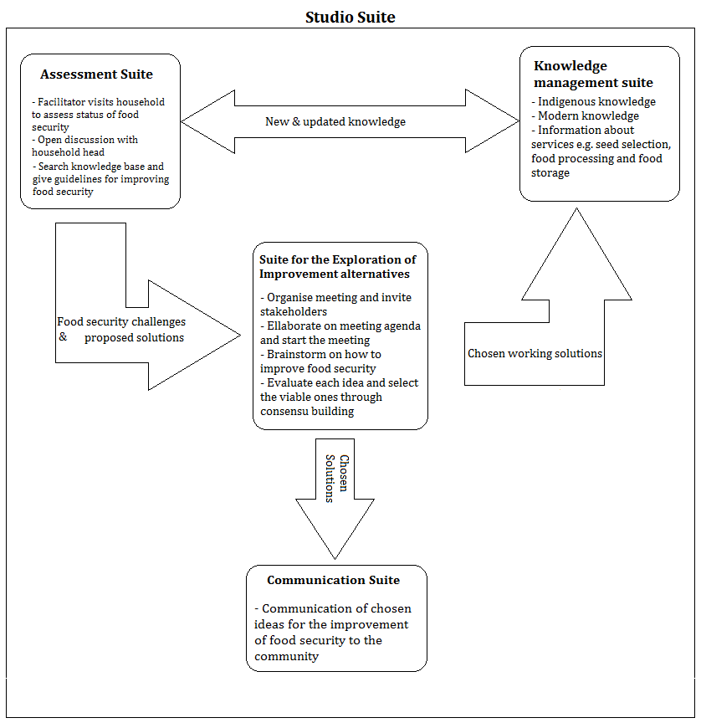
Indigenous Knowledge and Food Security
Problem | Managing and disseminating indigenous knowledge for sustainable food security in rural communities
Ennovation | Decision enhancement studio for rural communities’ food security
Framing:
Assessing, collaboration, communication and knowledge management
Collaborating:
Farmers, community Development Officers, Civil society groups, local leaders
Rehearsing:
Simulating

Slide 30
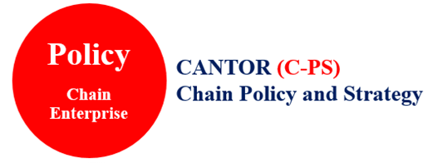
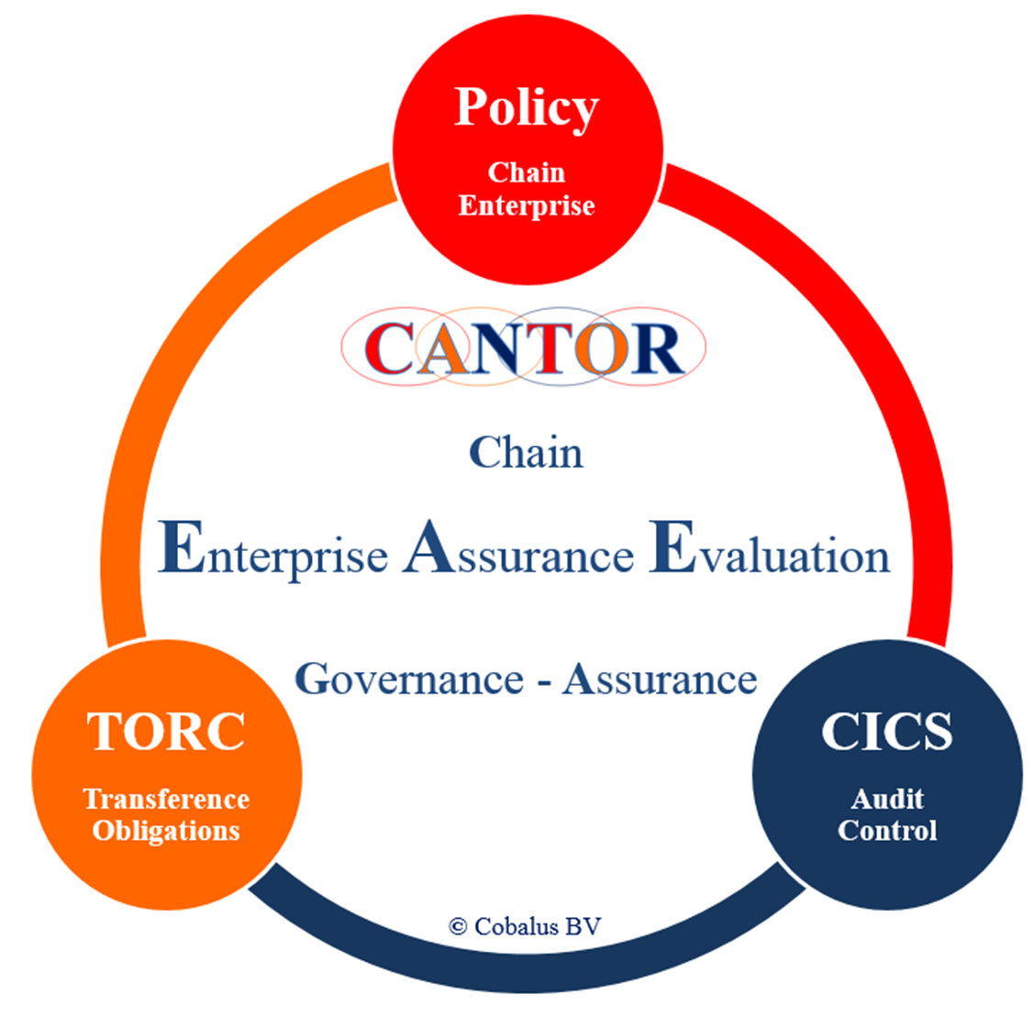
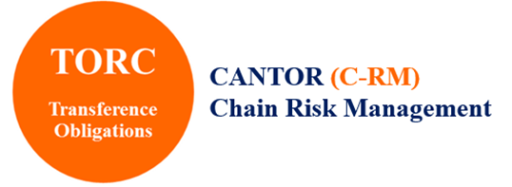


Problem | Establishing assurance when composite products or services are produced in Chain Enterprises
Ennovation | The CANTOR approach
Define Chain Enterprise Protocol
Chain Enterprise Principles
Enactment and Enforcement Policy
Maturity level of Risk Management and Auditing
Maximal CE Business Impact, Minimal CE Assurance level
TORC profile
Chain Enterprise Risk Assessment (SCN/SDN)
Timing and allocating Risk-Control Levels
Risk tolerance chain for chain enterprise
CICS profile
Audit (primary) enforcement rules
Timing and allocating auditing enforcement
Audit materiality for chain enterprise
EAE profile
Collect audit evidence, audit chain enterprise enforcement rules,
Cross-organizational attest Chain Enterprise (professional judgement)
Chain Enterprise Assurance Opinion
Drs Ype W. van Wijk RE RA

Slide 31
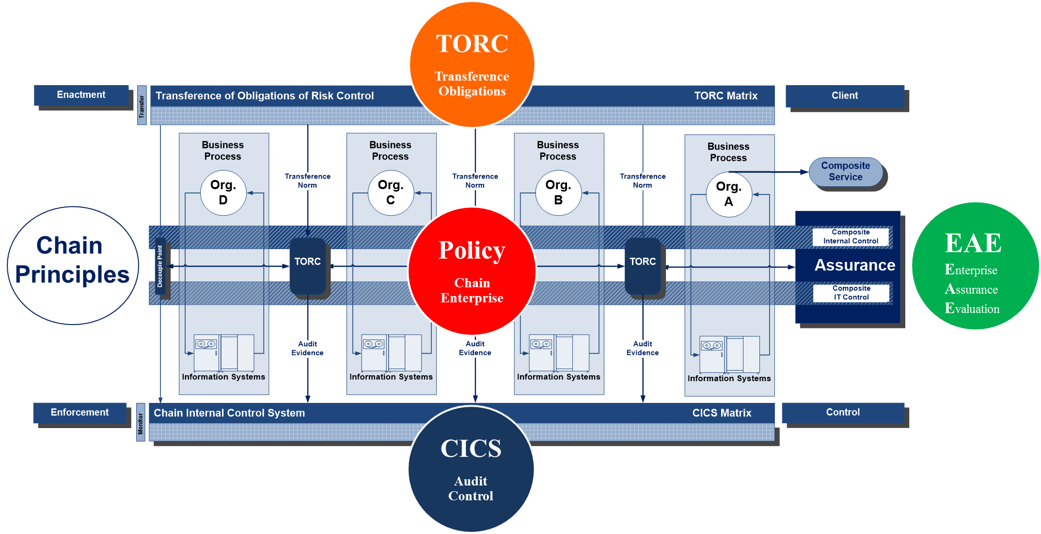
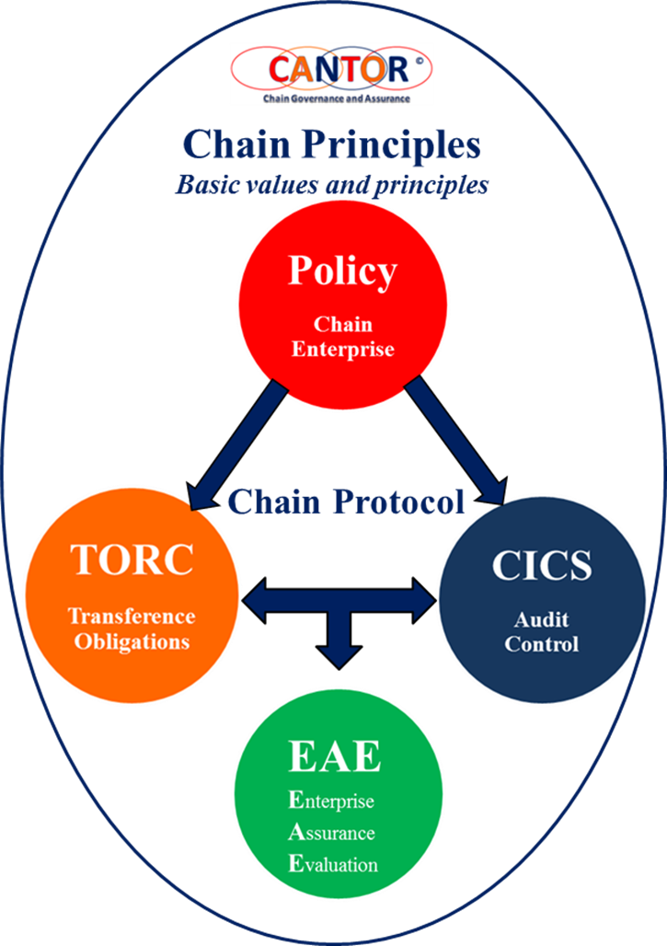
Assurance in Chain Enterprises
The CANTOR approach
Chain Enterprise Protocol
Enterprise Assurance Evaluation
Chain Enterprise Assurance attest, based on audit evidence and professional judgement
Cross-organizational attest
EAE opinion for the Chain Enterprise
Based on block chain technology
drs Ype W. van Wijk RE RA

Slide 32
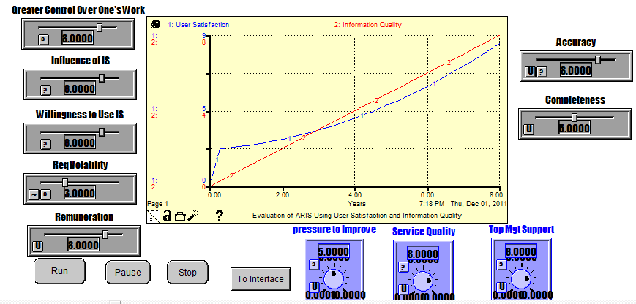
Dynamic Modeling of IS Success
Problem | Assessing Success of IS in Developing Countries
Ennovation | A Dynamic Instrument for Assessment
Paul Ssemaluulu Mukasa

Slide 33
Dynamic Modeling of IS Success
Problem | Assessing Success of IS in Developing Countries
Ennovation | A Dynamic Instrument for Assessment
Framing:
Documented failures exceeding 30% in developing countries
Shortage of skilled and knowledgeable personnel
Inadequate pay
Collaborating:
Multiple stakeholders creating better awareness
Rehearsing:
Simulating IS success Scenarios

Slide 34
Maternity Health
Problem | High Death Rate
Ennovation | A Decision Enhancement Platform for Maternity and Post-Natal Care
Framing:
Identifying maternity and post-natal care issues
Collaboration:
Engagement between the mothers, community health workers, gynecologists, nurses and midwives.
Rehearsing:
Experiments
Simulation

